Slide 1
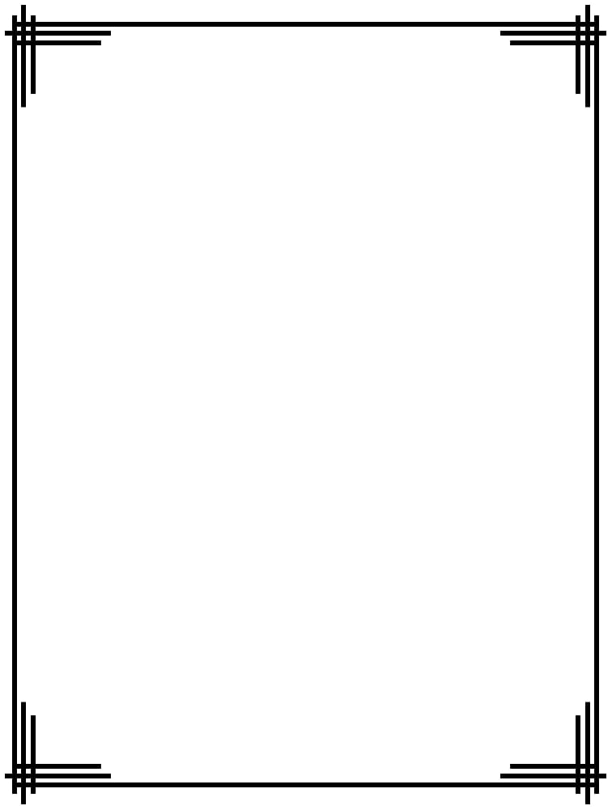


A CENTER FOR INTER-DISCIPLINARY RESEARCH
2018-19
DIAPREDIC
SUPERVISED BY
J.b.v Prasad Raju
B.S.V.S Anoop
GOKARAJU RANGARAJU
INSTITUTE OF ENGINEERING AND TECHNOLOGY
AUTONOMOUS

Slide 2
Advanced Academic Center
( A Center For Inter-Discilinary Research )
This is to certify that the project titled
DIAPREDIC
is a bonafide work carried out by the following students in partial fulfilment of the requirements for Advanced Academic Center intern, submitted to the chair, AAC during the academic year _______________________
NAME | ROLL NO. | BRANCH
D Sai Rakesh Reddy | 18241A05J6 | CSE
K Shreya Reddy | 18241A05K7 | CSE
This work was not submitted or published earlier for any study
Dr ./Ms./Mr.
Dr.B.R.K.Reddy
Program Coordinator
Dr.Ramamurthy Suri
Associate Dean,AAC
Project Supervisor

Slide 3

ACKNOWLEDGEMENTS
We express our deep sense of gratitude to our respected Director , Gokaraju Rangaraju Institute of Engineering and Technology for the valuable guidance and for permitting us to carry out this project.
With immense pleasure, we record our deep sense of gratitude to our respected principal, for permitting us to carry out this project.
We are thankful to Associate Dean ,Advance Academic Centre for providing us appropriate ecosystem required for the project to complete.
We are thankful to our project supervisor who spared valuable time for us and influence novel ideas to guide us. I am indebted to all the above without whom I would not have concluded the project.

Slide 4
TABLE OF CONTENT
1 | Acknowledgments | iv
2 | Abstract | vii
3 | Introduction | 1
4 | Literature Review | 2
5 | Software Specification | 4
6 | Software and Implementation | 5
7 | Software | 7
8 | Glossary | 8
9 | Future Scope | 9
10 | Reference | 10

Slide 5
INTRODUCTION
Diabetes is a major metabolic disorder which can affect entire body system adversely. Undiagnosed diabetes can increase the risk of cardiac stroke, diabetic nephropathy and other disorders. All over the world millions of people are affected by this disease. Early detection of diabetes is very important to maintain a healthy life. This disease is a reason of global concern as the cases of diabetes are rising rapidly. Machine learning (ML) is a computational method for automatic learning from experience and improves the performance to make more accurate predictions. In the current research we have utilized machine learning technique in Pima Indian diabetes dataset to develop trends and detect patterns with risk factors using R data manipulation tool. To classify the patients into diabetic and non-diabetic we have developed and analysed five different predictive model using R data manipulation tool. For this purpose we used supervised machine learning algorithms namely linear kernel support vector machine (SVM-
linear), radial basis function (RBF) kernel support vector machine, k-nearest neighbour (k-NN), artificial neural network (ANN) and multifactor dimensionality reduction (MDR).

Slide 6
LITERATURE REVIEW
2. LITERATURE REVIEW
This Literature review deals with the problem statement in detail. This is an analytical look at the previous research that is significant to the work that is carried out. A critical look at these available literatures related to the present work is given.
2.1. MACHINE LEARNING
Machine Learning is a sub-set of artificial intelligence where computer algorithms are used to autonomously learn from data and information. In machine learning computers don’t have to be explicitly programmed but can change and improve their algorithms by themselves.
Today, machine learning algorithms enable computers to communicate with humans, autonomously drive cars, write and publish sport match reports, and find terrorist suspects.
It all started in 1950’s when Alan Turing creates the “Turing Test” to determine if a computer has real intelligence. To pass the test, a computer must be able to fool a human into believing it is also human.

Slide 7
1952 — Arthur Samuel wrote the first computer learning program. The program was the game of checkers, and the IBM computer improved at the game the more it played, studying which moves made up winning strategies and incorporating those moves into its program.
1957 — Frank Rosenblatt designed the first neural network for computers, which simulate the thought processes of the human brain.
1967 — the “nearest neighbour” algorithm was written, allowing computers to begin using very basic pattern recognition.

Slide 8
SOFTWARE SPECIFICATIONS
We haven’t used any hardware tools in our project , since it is completely based on the based on datasets , data exploration and data analysis.
We have used the following soft ware for our diabetes prediction project:
The programming is completely done in python.
It is being compiled on Jupyter Notebook platform.
Python 3.7 version is being used for coding.
Python packages such as pandas , bumpy , sklearn are required to assess the base code.
CSV files are being used to store the datasets that are necessary to fit into our model.

Slide 9
SOFTWARE AND
IMPLEMENTATION
Dataset of female patients with minimum twenty one year age of Pima Indian population has been taken from UCI machine learning repository. This dataset is originally owned by the National institute of diabetes and digestive and kidney diseases. In this dataset there are total 768 instances classified into two classes: diabetic and non diabetic with eight different risk factors: number of times pregnant, plasma glucose concentration of two hours in an oral glucose tolerance test, diastolic blood pressure, triceps skin fold thickness, two-hour serum insulin, body mass index, diabetes pedigree function and age.
Random forests algorithms are used for classification and regression. The random forest is an ensemble learning method, composed of multiple decision trees. By averaging out the impact of several decision trees, random forests tend to improve prediction XGboost method can be also be used . It is advisable to use XGboost method as it finishes the task faster than Random forests and shows accurate and satisfying results.
.

Slide 10
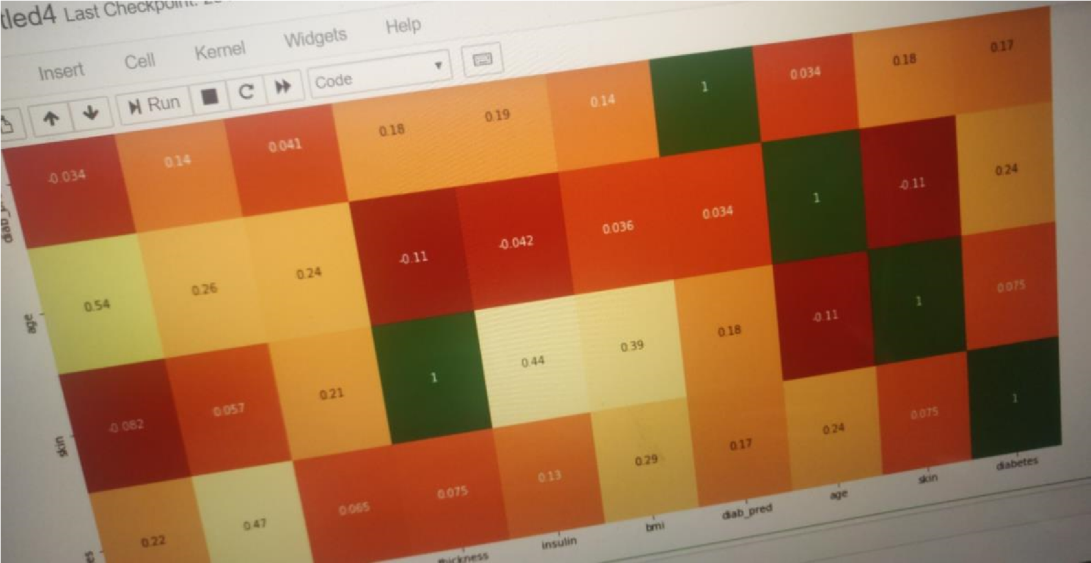
By using these different attributes we are predicting the outcomes of our target variable using different models and checking their accuracy. The dataset taken is pima-data.csv which contains a huge data on different attributes such as age, BMI etc. Our model basically checks the correlation between these attributes first on draws up a heat map. Using this we can make a table of the attributes. Then we make a change of all trues n false to 0’s and 1’s of target variable.
We look for null values in any of the attributes and update it to mean of the other set of values. This makes our train data ready for our model. On a whole we are basically training our machine by supervision learning by feeding it with data and expecting outcomes with complete accuracy. The machine will then be able to predict when new data is entered in the CSV file.

Slide 11
SOFTWARE
To predict outcomes of a future event a machine learning model is exposed to data from which it learns patterns that are used to predict the outcome. There are several methods for this purpose and studies have shown promising results. We use algorithms written in python/R.
5.1. Python
Python is an interpreted, high-level, general-purpose programming language. Created by Guido van Rossum and first released in 1991, Python's design philosophy emphasizes code readability with its notable use of significant whitespace. Its language constructs and object-oriented approach aim to help programmers write clear, logical code for small and large-scale projects.
5.2. R
R is a programming language developed by Ross Ihaka and Robert Gentleman in 1993. R possesses an extensive catalog of statistical and graphical methods. It includes machine learning algorithm, linear regression, time series, statistical inference to name a few. Most of the R libraries are written in R, but for heavy computational task, C, C++ and Fortran codes are preferred.

Slide 12
GLOSSARY
CSV : Comma separated values files store all the data in a file ,where the data is separated by comma's.
XGboost model: It is a machine learning approach to achieve faster and accurate results in very less time.
Dataset: It is a collection of all the information about various parameters used to train our model.
Regression models: A regression model is used to investigate the relationship between two or more variables and estimate one variable based on the others.

Slide 13
FUTURE SCOPE
The reading of HBA1C was not found significant in the study. This raises question on over glorification of this tool as predictor of the diabetes. Are the simple anthropometric variables like Waist Circumference better predictor, than the three month average Blood Glucose Level?
A multicentre study with more variables can give different results. More variables can be included using Delphi Method. The present methodology used i.e. Logistic Regression can be compared with more advance tools like ANN (Artificial Neural Network) for the results.

Slide 14
REFERENCES
https://www.analyticsvidhya.com/blog/2018/05/24-ultimate-data-science-projects-to-boost-your-knowledge-and-skills
https://www.google.com/url?sa=t&source=web&rct=j&url=http://www.ijera.com/papers/Vol8_issue1/Part-2/C0801020913.pdf&ved=2ahUKEwim2JHB9rrjAhVT6XMBHeKWCzEim2JHB9rrjAhVT6XMBHeKWCzEim2JHB9rrjAhVT6XMBHeKWCzE
https://www.google.com/url?sa=t&source=web&rct=j&url=https://www.researchgate.net/publication/316432650_Diabetes_Prediction_Using_Medical_Data&ved=2ahUKEwim2JHB9rrjAhVT6XMBHeKWCzEQFjACegQIBBAC&usg=AOvVaw3anPriATr4lmdAtItY7_sc
https://www.google.com/url?sa=t&source=web&rct=j&url=https://journalofbigdata.springeropen.com/articles/10.1186/s40537-019-0175-6&ved=2ahUKEwim2JH.

